Slide 1
GSERM: Text Mining & NLP Intros
Ted Kwartler

Slide 2
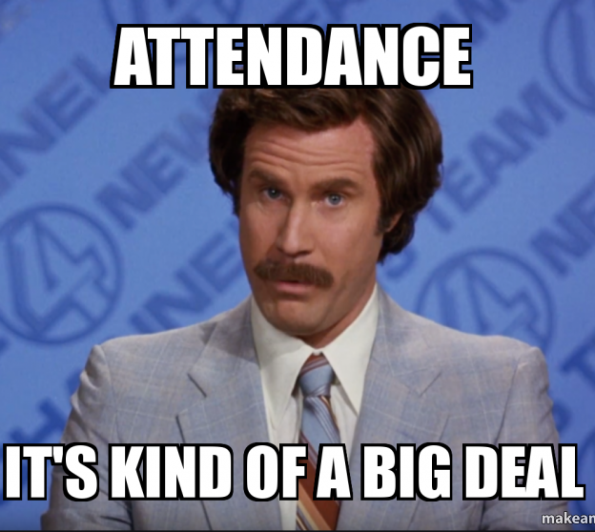

Slide 3
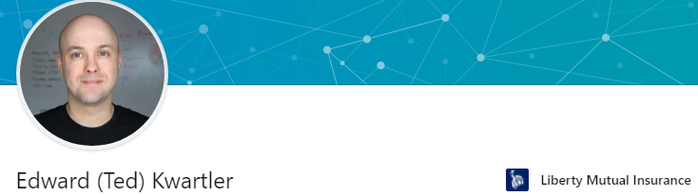










https://www.linkedin.com/in/edwardkwartler/
Side Hustles

Slide 4
Introductions…
Name
Location
Background
Why are you taking this course?
Are you working on VM, local or cloud?

Slide 5
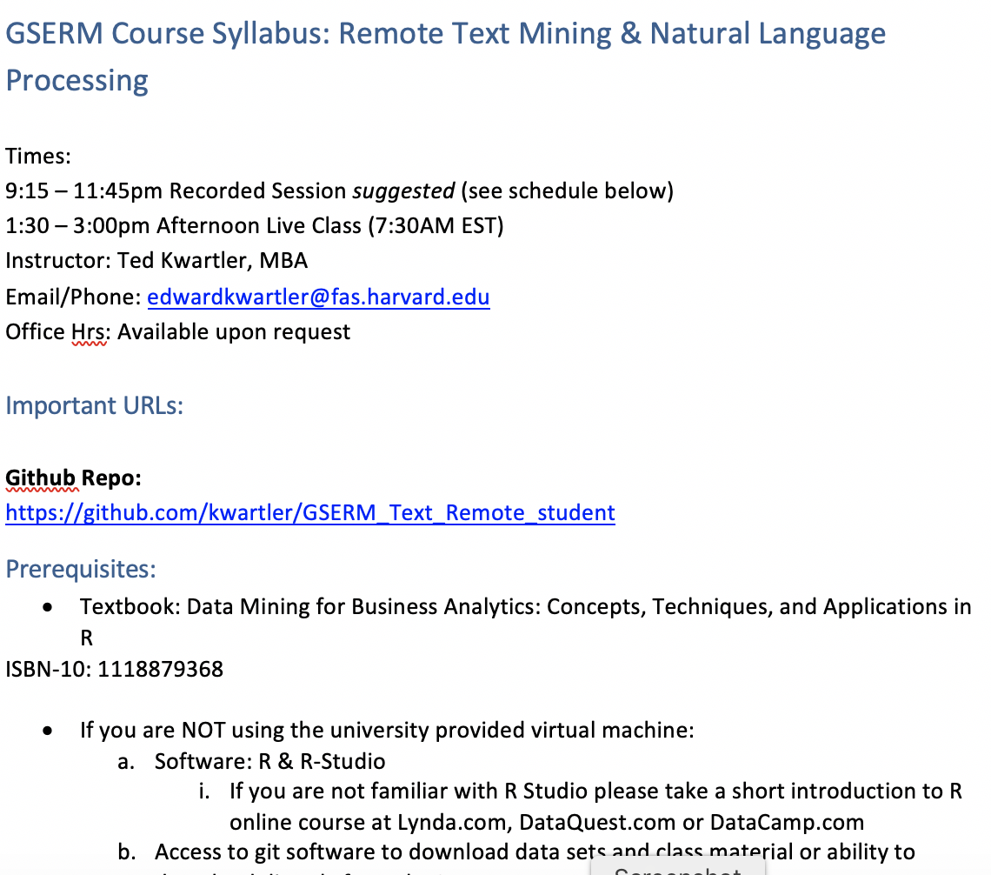
Syllabus Review

Slide 6
Community Learning Expectations
I expect:
Kindness > Cleverness
Active learning & participation
To make adjustments along the way so learning will be engaging & fun
Academic rigor
My goal for your learning experience is that the topics are:
Interesting
Applicable as a professional, researcher or future business person
Perspective building as a consumer affected by these methods
I do not expect:
Expert programmers or production quality coding skills – not really a programming course
Significant math skills – not a heavy math course

Slide 7

A safe/supportive learning environment
In this class, we use a lot of tweets…which have never been read.
“Keyboard Courage” is rampant which may entail some less than ideal topics.
Twitter is a realistic Natural Language Channel
It is a great place to get topics, and messy challenging data.
As a safe learning environment, no offense is intended, merely exposure to a real data set. If offended, please reach out and I will get you additional data sets.
#%@*!!!

Slide 8
My style
You learn from being challenged
This is a intensive 1 week course requiring programing.
Don’t be intimidated if its your first time with R. My job is your learning outcomes. I am here to help.
It can be uncomfortable learning something new.
Discomfort means you are applying/challenging yourself. It’s ok and expected.
The professor doesn’t give everyone the top scores & no extra credit.
You earn the actual grade but I am fair and reasonable
“Homework/reading is taking hours & I want to go to social activities.”
You are earning credit in an intensive manner. Expect intensity and rigor at a prestigious institution.

Slide 9

Some motivation
If you are struggling, ask Prof help, evening labs, lunchtime office hours, email or even smoke signals, whatever it takes to succeed.
Focus on your learning outcomes
Don’t focus on your grade
You own the level of effort & engagement in your learning
I am focused on your learning outcomes
I don’t care if you need a specific grade to graduate
I take my role seriously mirroring your effort & engagement to support learning

Slide 10
Video 1 Q/A
Who had trouble installing R?
Who had trouble installing Rstudio?
Who had trouble installing Git?

Slide 11
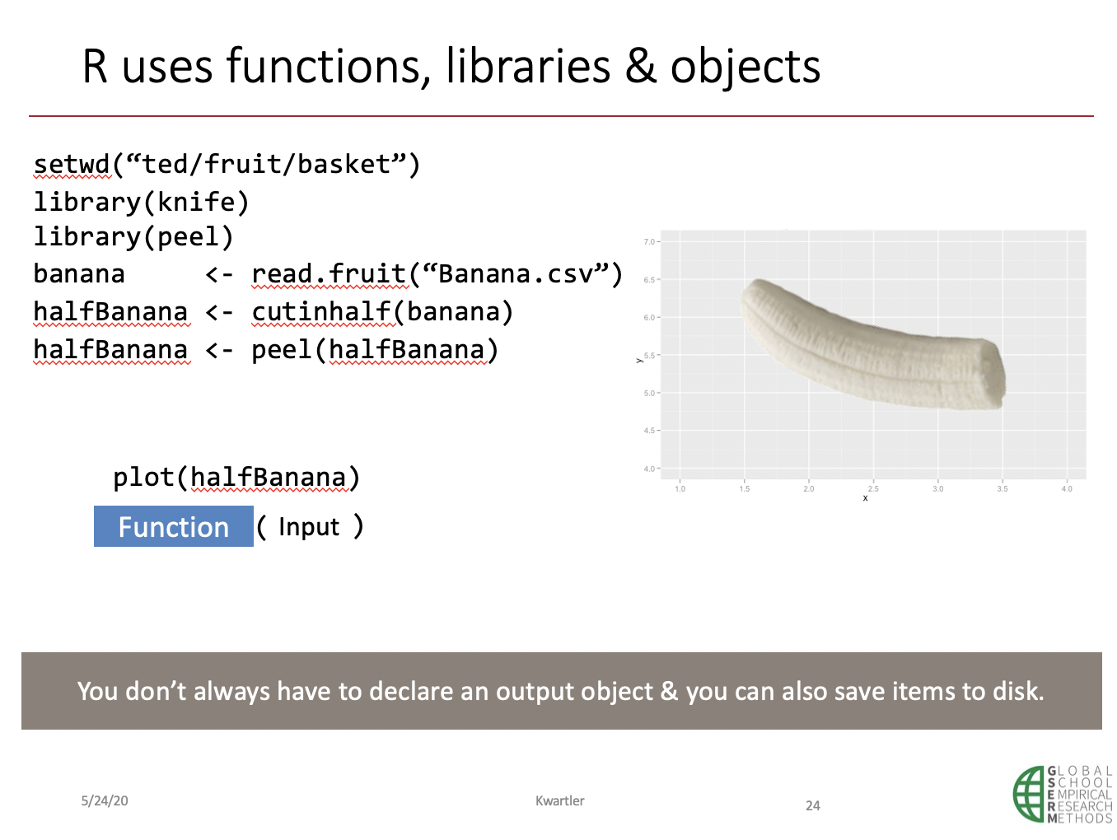
Video 2 Q/A
Does the input, function, output process make sense?
Does the banana analogy and workflow make sense?
What is “<-” called?
Why do we need libraries in R?

Slide 12
In video 3, we took R for a test drive.

Slide 13
Let’s get back into R, to review.
Please open live_A_more_basics.R

Slide 14
GSERM: Text Mining & NLP TM Basics

Slide 15
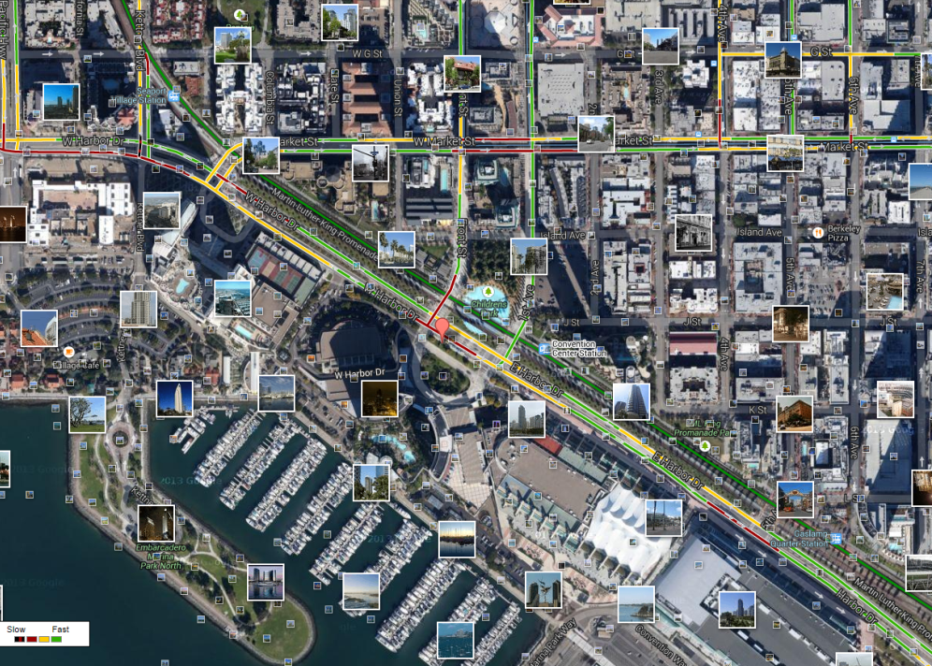
What is Text Mining?
Before Text Mining
Extract new insights from text
Let’s you drink from a fire hose of information
Language is hard; many unsolved problems
Unstructured
Expression is individualistic
Multi-language/cultural implications

Slide 16
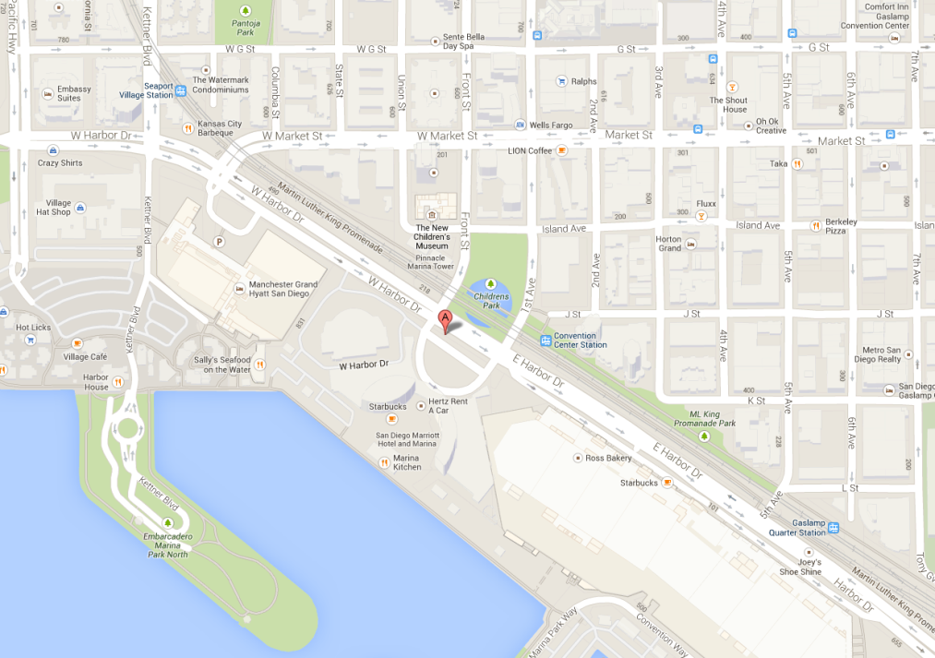
What is Text Mining?
After Text Mining
Extract new insights from text
Let’s you drink from a fire hose of information
Language is hard; many unsolved problems
Unstructured
Expression is individualistic
Multi-language/cultural implications

Slide 17
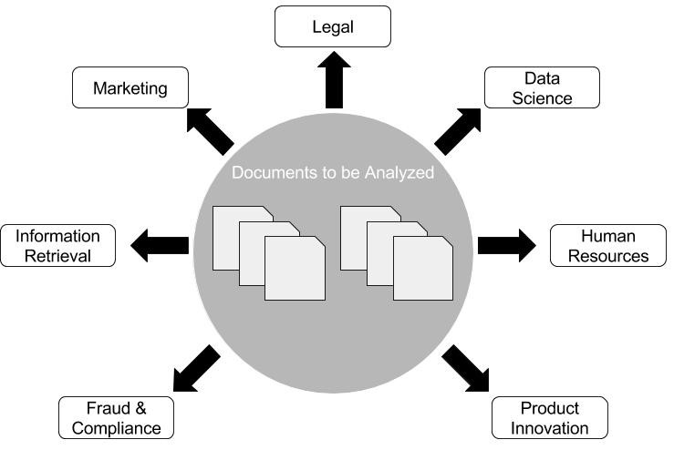
Where can NLP & Text Mining be used? Anywhere there are documents!

Slide 18
Where do you observe NLP? What about your research ideas?

Slide 19
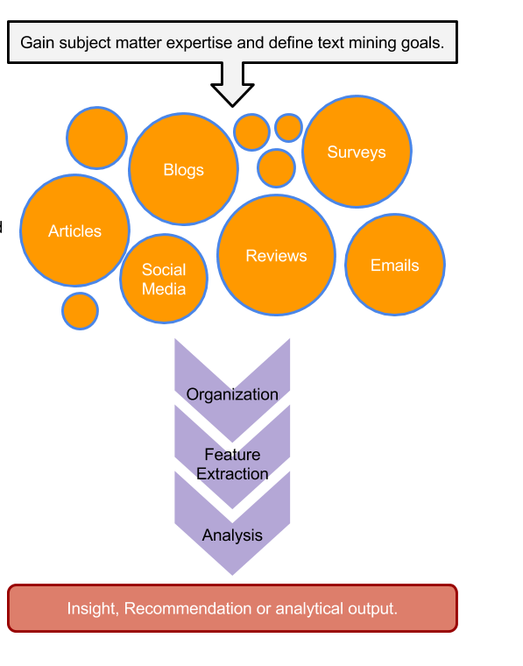
TM Project Workflow
Unorganized State
Natural Language Processing & Analysis
Organized State

Slide 20
Text Mining Workflow
Problem Definition
Identify Text Sources
Text Organization
Feature Extraction
Analytics
Reach Insight or Recommendation

Slide 21
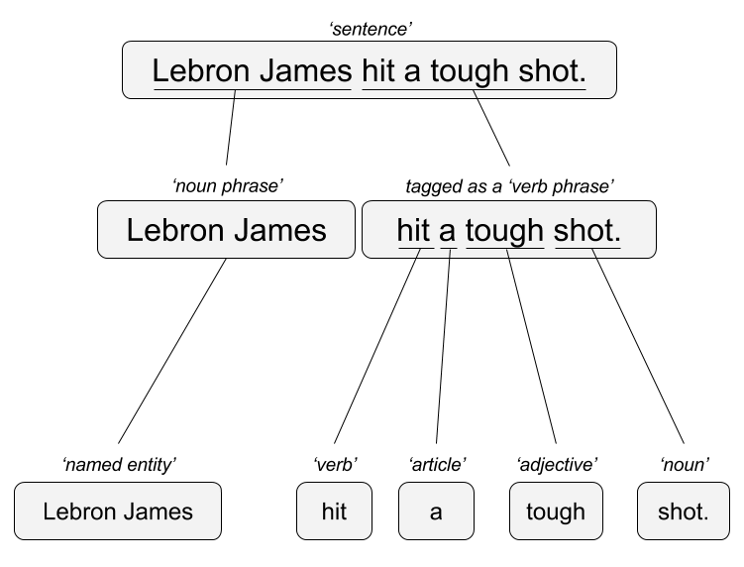

Two Popular Approaches
“Lebron James hit a tough shot.”
Syntactic Parsing
Bag of Words
Lebron
a
James
hit
tough
shot
*There are other approaches usually based on DNN, that I refer to “abstractive”

Slide 22


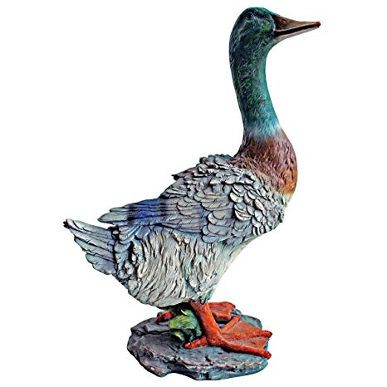

TM Challenges - Disambiguation
I made her duck.
I cooked waterfowl for her to eat.
I cooked waterfowl belonging to her.
I created the (clay?) duck and gave it to her.
Duck!!

Slide 23
TM Challenges - Misc
Other Challenges
Examples
Compound words (tokenization) change meaning
Sarcasm
Cultural differences
“Bad” vs “not bad”
“I like it…NOT!”
“It’s wicked good” (in Boston)

Slide 24





Why text mining is an art & science?
Challenges because human expression is diverse, often ambiguous, affected by age, demographics, socio-economics, medium/channel & regional attributes of the author.
Common Sources
Source & context are important, directly impacting data integrity.
Books
Electronic Docs (PDFs)
Blogs
Websites
Social Media
Customer Records
Customer Service Notes
Notes
Emails
Legal Documents
…

Slide 25



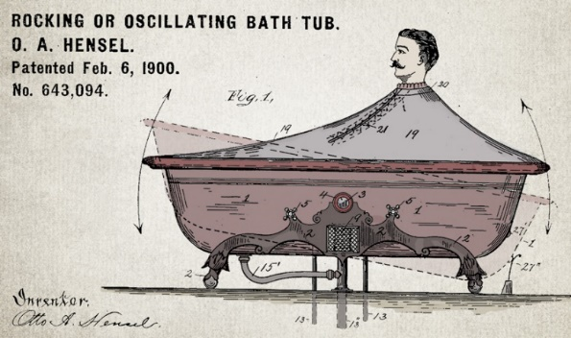


Channel affects language
Legal documents are verbose & technical.
“Be the change you want to see in the world.”
“kappa” indicates sarcasm, irony,
or a joke among online gamers.
Expression is context specific making analysis challenging.

Slide 26

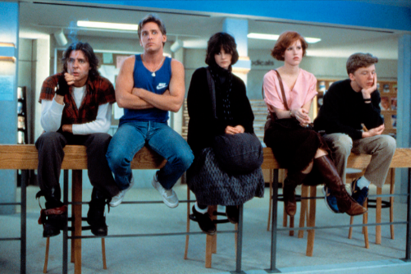

Messenger affects language
Boomers 1946-1964
* Make a difference * Consensus/team * Experiment/try new things * “Imagine if…” * Save time * Features and benefits
Gen X 1965-1980
Best, finest, world-class
“You will benefit by…”
”This is in your best interest.”
Gen Y 1981-2000
Global citizen
Balance
Diversity
Community/connections
Beyond generation, other factors like socio-economic, gender & demographic makeup impact expression.
https://www.anneloehr.com/

Slide 27


Gen Y/Z expression is evolving rapidly due to technology.
“Thank you, next.”
“Woke”
“Cray”
“Gucci”
“Squad goal”
“Bible…”
“Adulting”
“Turnt”
“Hundo P”
“Trill”
“TFW”
Beyond generation, other factors like socio-economic, gender & demographic makeup impact expression.

Slide 28
Gen Y/Z expression is evolving rapidly due to technology.
“Thank you, next.” – moving on with positive connotation
“Woke” - The more woke one is, the more sympathetic & knowledgeable one is about a topic or type of person
“Cray” - crazy
“Gucci” – fine, good
“Squad goal” – friend group behavior
“Bible…” - what follows is TRUTH
“Adulting” – activities associated with growing up
“Turnt” – “turned up” i.e. really excited
“Hundo P” – agree “100%”
“Trill” – True & Real
“TFW” – “That Feeling When” to describe an emotion
Beyond generation, other factors like socio-economic, gender & demographic makeup impact expression.

Slide 29




Audience affects language
And we all context switch based on who were are speaking too.

